Slide 1
WATER BILLING APP

Slide 2
Problem Statement
Water billing companies in Kenya have had a long and tedious process of collecting meter readings, processing bills and customer being able to make payments. The process has been time consuming with records maintained manually including calculations. This therefore increases chances of error and data retrieval quite tasking

Slide 3
Proposed Solution
The application should enable the enforcement officers to enter meter numbers and automatically generate the consumption and amount owed to the company as per current bill. This will reduce the time spent to do billing and payments.
Also, the app will enable officers to do enforcement for illegal connections and updating on records.

Slide 4
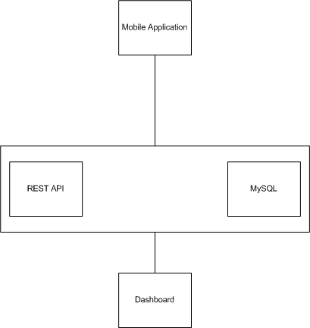
Solution Architecture

Slide 5
Monetization Angle
The application can be bought outright by the water company for them to conduct their billing and payment processes.
Since there will be transactions, one could opt to do revenue share with the water company for each transaction done on the system.

